Slide 1
Lecture 2.
Introduction to Digital Image
Processing

Slide 2
Digital Image and Digital Image Processing
• Image - A two-dimensional signal that can be observed by human visual system
• Digital image - Representation of images by sampling in time and space.
• Digital image processing - perform digital signal processing operations on digital images

Slide 3
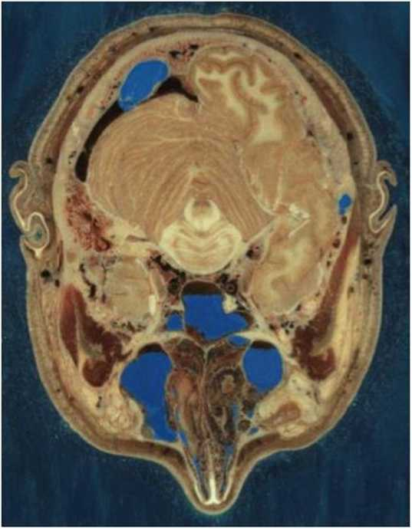
Examples of DIP:
CT: Computer Tomography
• http://www.nlm.nih.gov/research/vi sible/image/head.jpg
• Section through Visible Human Male - head, including cerebellum, cerebral cortex, brainstem, nasal passages (from Head subset)
• This is an example of the “visible human project” sponsored by NIH
• DIP techniques applicable:
- Enhancement
- Segmentation

Slide 4
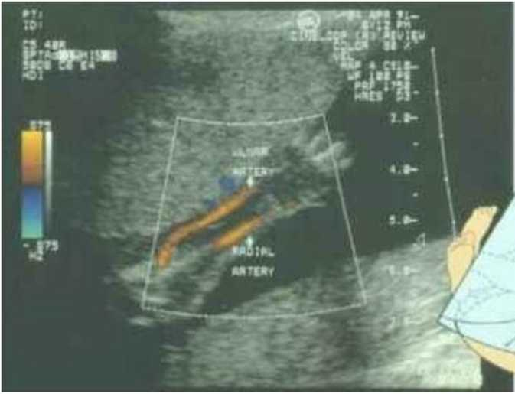
Ultrasound Image
Profiles of a fetus at 4 months, the face is about 4cm long
Ultra sound image is another imaging modality
The fetal arm with the major arteries (radial and ulnar) clearly delineated.

Slide 5
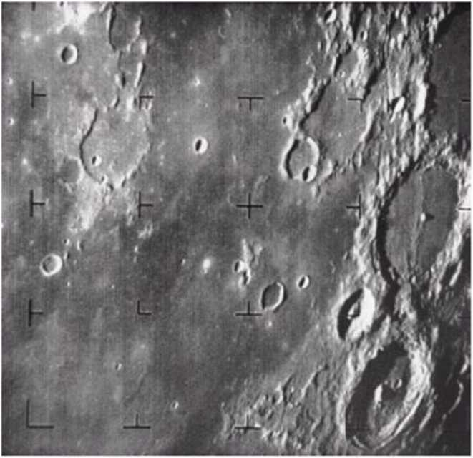
Chapter 1: Introduction
FIGURE 1.4 The
first picture of the moon by a U.S. spacecraft.
Ranger 7 took this image on July 31. 1964 at 9:09 A.M. EDI. about 17 minutes before impacting the lunar surface. (Courtesy of NASA.)'

Slide 6
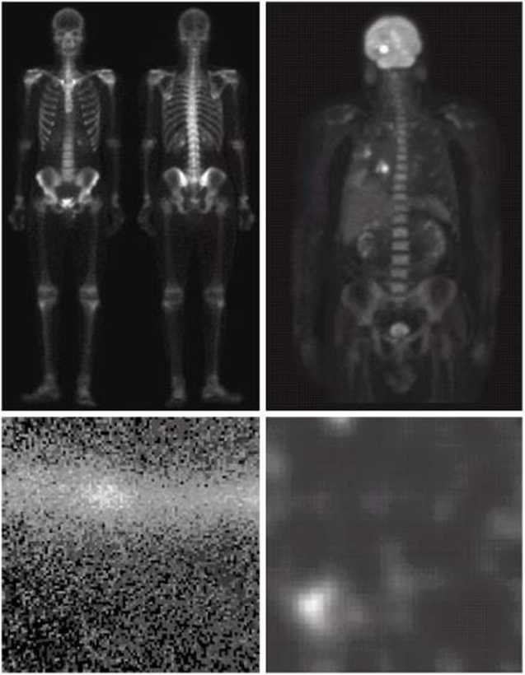
Chapter 1: Introduction
a b c d
FIGURE 1.6
Examples of gamma-ray imaging, (a) Bone scan, (b) PET image, (c) Cygnus Loop, (d) Gamma radiation (bright spot) from a reactor valve. (Images courtesy of (a) G.E. Medical Systems.
(b) Dr. Michael E. Casey. CTI PET Svstems.
(c) NASA.
(d) Professors Zhong He and David K. Wehe. University of Michigan.)

Slide 7

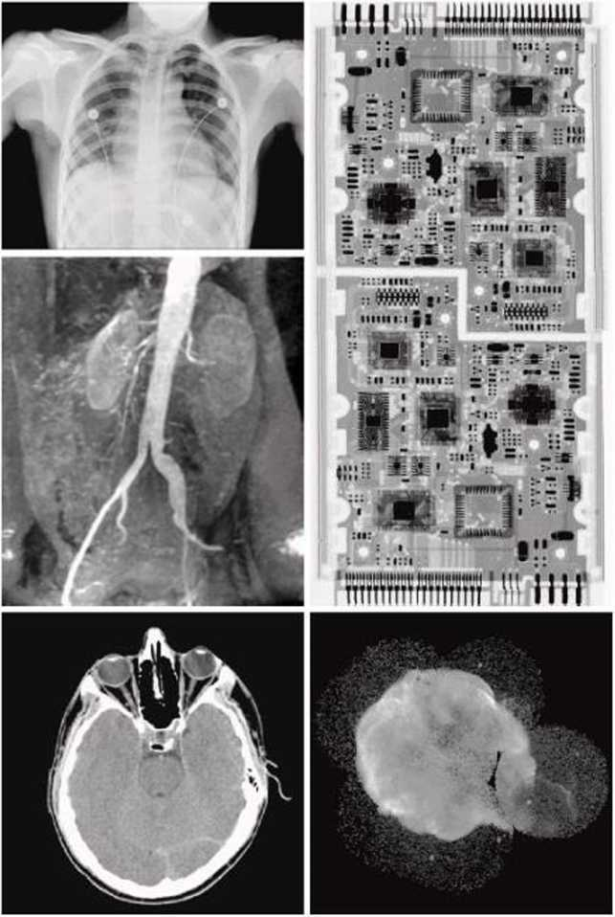
1; Introduction
a b | d
c | e
Figure 1.7 X-Ray images, (a) Chest X-ray. (b) Aortic angiogram, (c) Head CT. (d) Circuit boards, (e) Cygnus Loop.
FIGURE 1.7 Examples of X-ray imaging, (a) Chest X-ray. (b) Aortic angiogram, (c) Head CT. (d) Circuit boards, (c) Cygnus Loop. (Images courtesy of (a) and (c) I)r. David R. Pickens. Dept.of Radiology &. Radiological Sciences. Vanderbilt University Medical Center, (b) Dr. Thomas R. Gest. Division of Anatomical Sciences. University of Michigan Medical School, (d) Mr. Joseph E. Pasccnte.Lixi. Inc..and (e) NASA.)

Slide 8
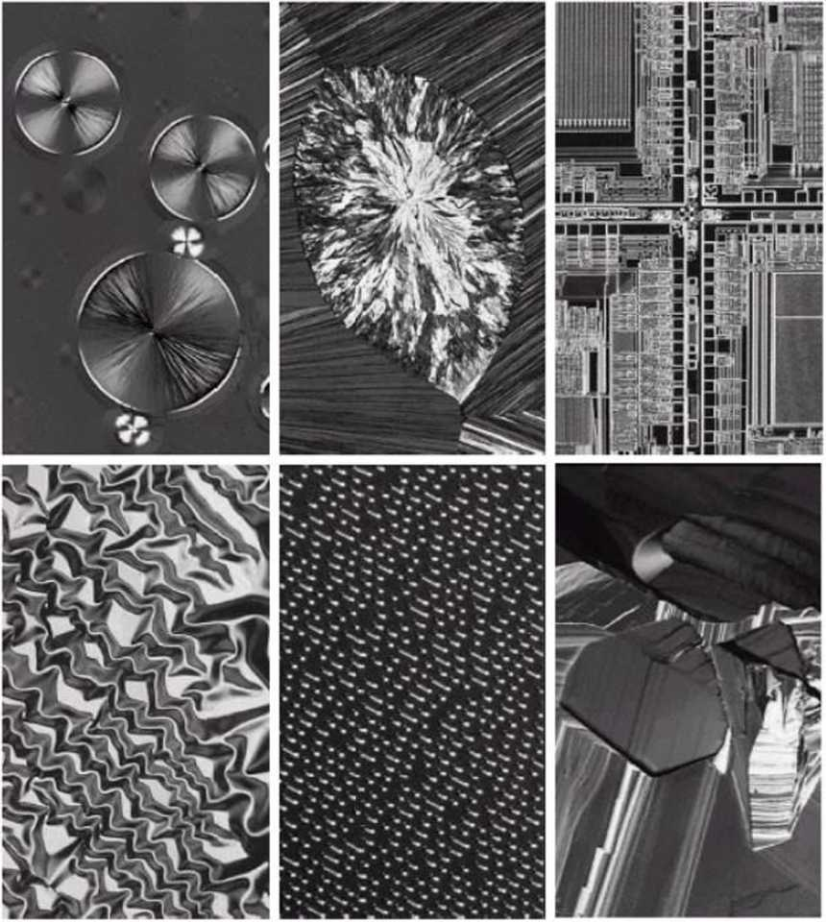
Chapter 1: Introduction
a h c d e f
Figure 1.9 Light microscopy images, (a) Taxol (anticancer agent), magnified 250X, (b) Cholesterol, 40X (c) microprocessor 60X. (d) Nickel oxide thin film, 600 X.
(e) Surface of audio CD 1750 X. (f) Organic superconductor 450 X.

Slide 9
Why DIP?
One picture worth 1000 words!
Support visual communication
Facilitate inspection, diagnosis of complex systems
- Human body
- Manufacturing
• Entertainment
• Keep record, history
• Managing multimedia information
• Security,
- monitoring,
- watermarking, etc

Slide 10
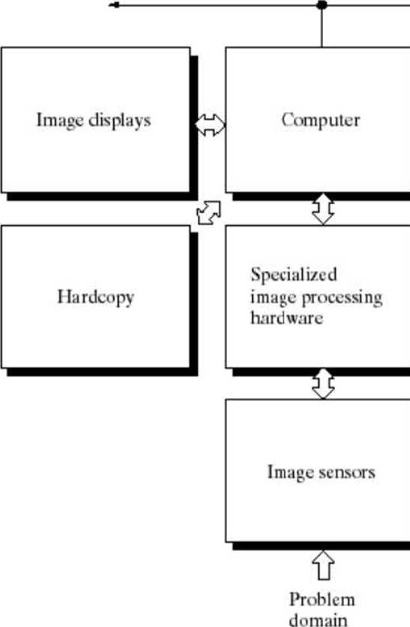
Chapter 1:
Network
 | Mass storage
 | Image processing software
FIGURE 1.24
Components of a general-purpose image processing system.

